Slide 1
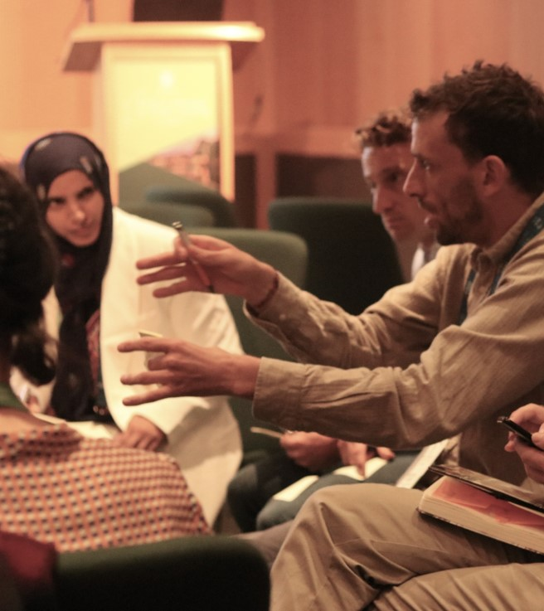
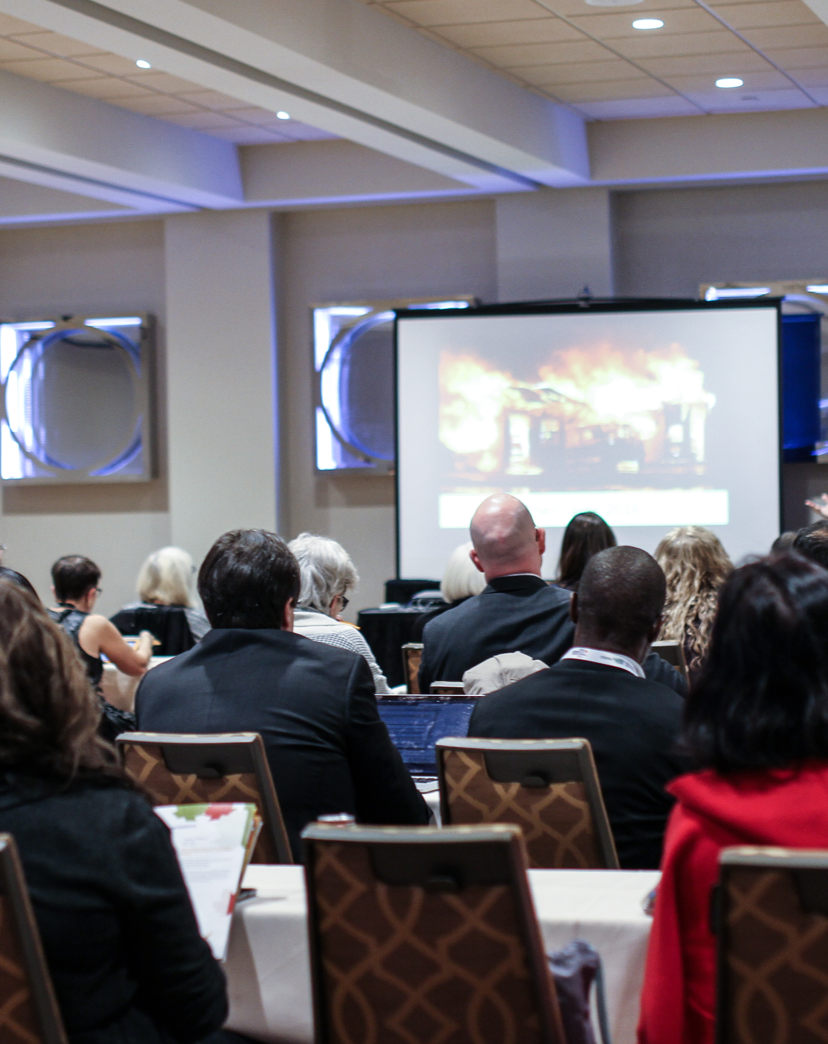

Opportunities and Challenges of the UNESCO OER Recommendation in Francophone Africa
Focus on Capacity Building and Supportive Policies
Anaïs Røed Malbrand
Senior Adviser
Notes:
My name is Anaïs Røed Malbrand and I am a senior advisor in ICDE. I am the project coordinator for the Francophone OER Project

Slide 2
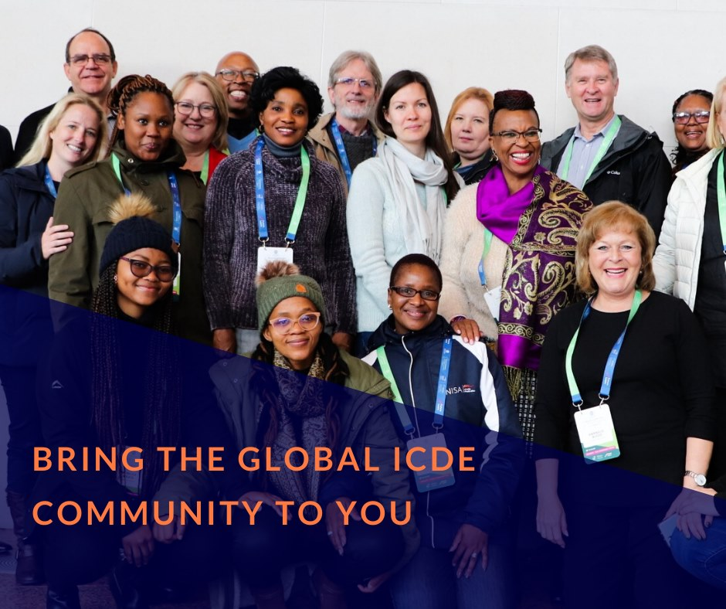
ICDE at a glance
ICDE Vision:
“To achieve the potential of Open, Flexible, and Distance Learning created through our members and learning communities.”
Founded 1938 in Canada
A global, not for profit NGO and membership association
Hosted and partly funded by Norway since 1988
In formal consultative partnership with UNESCO
Notes:
Let me first start with an introduction to ICDE, and a brief look back on our long and proud history.
ICDE was first established as the International Council for Correspondence Education back in 1938 in Canada. We are the leading and oldest membership association in our field.
As a not for profit NGO, the association has, since 1988, been hosted by Norway, with finanical support from the Norwegian Ministry of Education and Research. ICDE has also been in a formal consultative partnership with UNESCO since the 1960’ies.
We work with policy development and global advocacy for Open, Flexible and Distance Learning together with our partners and members, as well as dissemination and development of knowledge and research related to our field. We organize conferences and events, connect experts through networks and committees, and facilitate partnerships and collaboration across borders, time zones, regions and cultures.

Slide 3
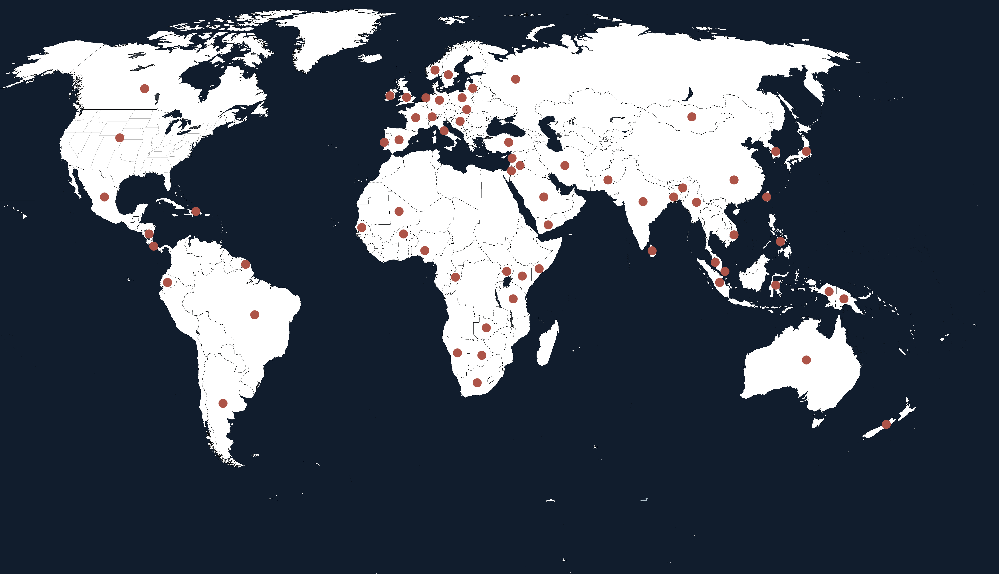
Our global outreach
330+ members and partners
70 countries in all world regions
impacting over 15 million students across all continents
Notes:
ICDE has more than 330 members and partners impacting over 15 million students across all continents of the world. Through the engagement of these members and partners, ICDE is able to undertake projects, organize conferences and events, and disseminate the latest knowledge and research in our field through expert networks and special interest groups that our members take part in.
Our members are educational institutions, regional associations, private companies, individual academic experts and students. They come from over 70 different countries in all world regions, as shown on the map.

Slide 4

What are Open Education Resources (OER)?
Open Educational Resources (OER) are learning, teaching and research materials in any format and medium that reside in the public domain or are under copyright that have been released under an open license, that permit no-cost access, re-use, re-purpose, adaptation and redistribution by others.
(UNESCO)
Notes:
My apologies if this is already basic knowledge for you, but I take the chance to quickly highlight the definition of OER, before going onwards:

Slide 5
What is an open license?
Open license refers to a license that respects the intellectual property rights of the copyright owner and provides permissions granting the public the rights to access, re-use, re-purpose, adapt and redistribute educational materials. (UNESCO)
Important distinction between copyright and usage rights
Notes:
A common misconception is that an open license «gives away» all intellectual property rights. This is not true. An open licsense respects the intellectual property right of the copyright owner, and in addition, is provides permissions for various degrees of usage rights.

Slide 6

The Potential of OER
Increased access to learning resources and materials for all
Alternative to expensive textbooks and resources behind pay walls
Educators can adapt and reuse resources (local adaptation, translation, adaptation for learners with special needs etc.)
Everyone can contribute to updating, development and refinement of the resources (innovation aspect)
Notes:
This innovative potential is especially linked to the two last points on this slide. The fact that educators can adapt and reuse learning resources and that everyone, including students, can contribute with updates, development and improvement of learning resources. The innovative aspect comes in addition to the cost effectiveness and the fact that open licenses increase the access to learning resources for all.

Slide 7
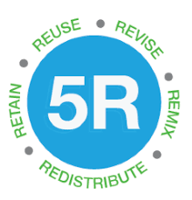
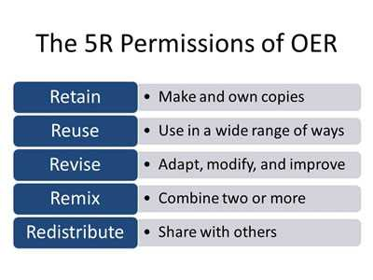
The 5 Rs of OER
CC-BY BCOER Librarians CC 4.0
5R Open Course Design Framework by eCampus
Notes:
In English, the 5 Rs of OER is a helpful extract of the various usage rights that can be enabled through OER.

Slide 8
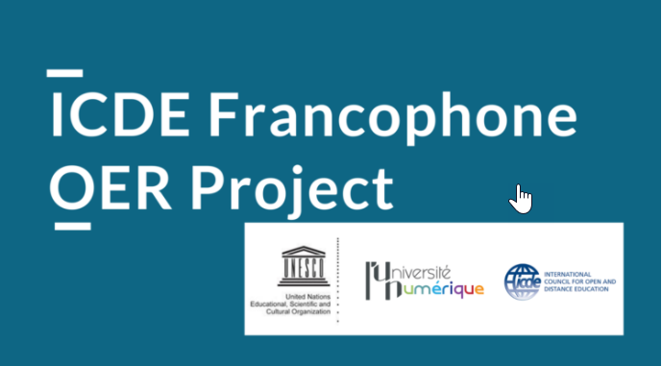
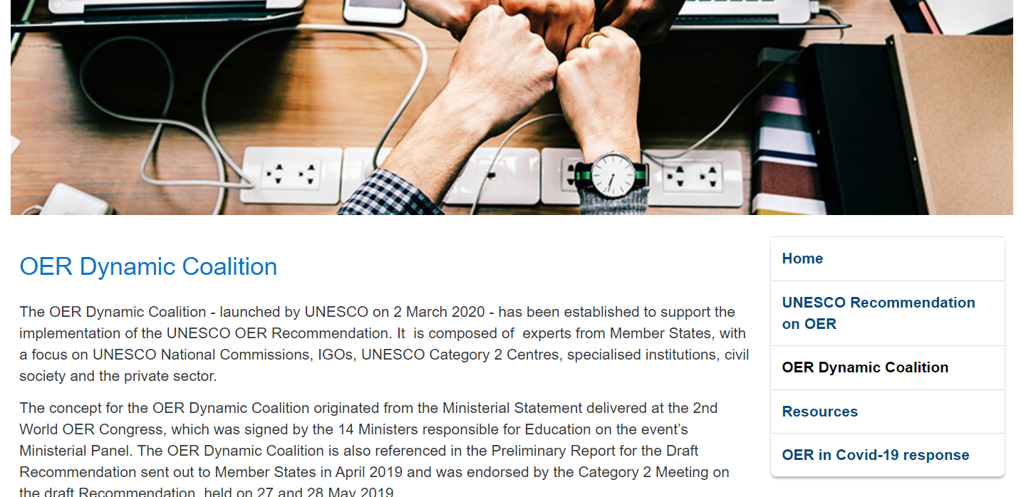


Examples of ICDE’s work in the field of OER
Notes:
I will now quickly mention some of concrete activities that ICDE is undertaking within Open Education and OER.
As member of the UNESCO OER Dynamic Coalition, ICDE supports in multiple action areas in the implementation of the UNESCO OER Recommendation, both through our Advocacy Committee for OER, and through concrete projects.
The ICDE OER Advocacy Committee works to increase global recognition of OER; and to provide policy support for the uptake, use and reuse of OER. It consists of 12 ambassadors for OER, representing all world regions, and is chaired by ICDEs board member from Sweden, Prof. Ebba Ossiannilsson.
The ENCORE + project is a European ERASMUS + project aiming to establish a network for catalysing Open Resources in education and developing innovation and entrepreneurship with OER that benefits both academica and business. The project is coordinated by ICDE and run by various European partners who come from both higher education and the private business sector.

Slide 9
Origins of the working group and project
December 2018: Open Education Leadership Summit. Paris
November 2019: Adoption of the UNESCO OER Recommendation
March 2020: First face to face meeting of the working group in Paris
ICDE member French Ministry for Higher Education, Research and Innovation (MESRI) and ICDE agree on the opportunity of tapping into the ICDE global, expert network to support their West African and French partners stakeholders by establishing a Francophone working group

Slide 10

Francophone
Expert group in short:
Current Members
Potential Future Partners
French Digital University (L’Université Numérique – UNIT, AUNEGe and UOH)
French Ministry of Higher Education, Research and Innovation
Virtual Universities of Senegal, Mali, Ivory Coast and Republic of Congo
French National Commission for UNESCO
UNESCO
International Organisation of La Francophonie
ICDE
Virtual Universities of Bénin, Burkina Faso, Niger and Central African Republic
Ministries of Bénin, Burkina Faso, Côte d’Ivoire, Niger and Central African Republic, Senegal, Mali and Republic of Congo
Business partners
Notes:
The working group is composed with representatives from the French Ministry for Higher Education, Research and Innovation, the French Digital University (UNIT, AUNEGe and UOH), the Virtual Universities of Senegal, Mali and Republic of Congo. Representatives from UNESCO Headquarters, the French National Commission for UNESCO, the French UNESCO Chair in OER and the International Organization of la Francophonie.

Slide 11

OER Francophone Africa working group and project
Capacity building
Needs identification
Multisectoral dialogue
Academic/policy level
Catalyzing nature
Synergies with parallel initiatives in the region at ICDE and UNESCO
Cultural approach and replicability
French
Course/capacity building material
Roadmap
Multisectoral nature of the expert group
Language and cultural validation of capacity building material
Project’s key components:
UNESCO OER Recommendation
OER capacity building (Area 1) &
Supportive policies (Area 2)
Notes:
The project focuses on area 1 and 2 of the UNESCO OER Recommendation: capacity building and supportive policies
4 key components: capacity building/multisectoral dialogue/cultural approach and replicability/catalytic (synergies with parallel initiatives with partners and in the region: course, Sahel, UNESCO ICT competency framework)
We have now ended the first pilote phase of the project and are planning for next steps.
Key success factors:
Workshop:
Multisector dialogue (academic and policy level + private/public)
Synergies with UNESCO Sahel (parallel organisation of Ministerial Forum that will take place on October 22nd with already identified focal points and work done on needs analysis)
Support of OER Francophone expert working group to identify capacity building material and participants to the Workshop.
Virtual format makes it more inclusive
Course:
International cooperation with key partners with culturally appropriate leadership and ownership, strong networks and technical but also linguistic and legal strong skills.
More details in next presentations
The ICDE Francophone OER Project is established through a collaboration between UNESCO, The French Digital University, and with substantial contributions from the OER Universitas in New Zealand. It aims to support capacity building and the development of supportive policies for the implementation of the UNESCO OER Recommendation in Francophone Africa.
The countries covered by Workshop and the project are Senegal, Burkina, Mali, Togo, Benin, Ivory Coast, Republic of Congo, Burundi and Gabon.

Slide 12
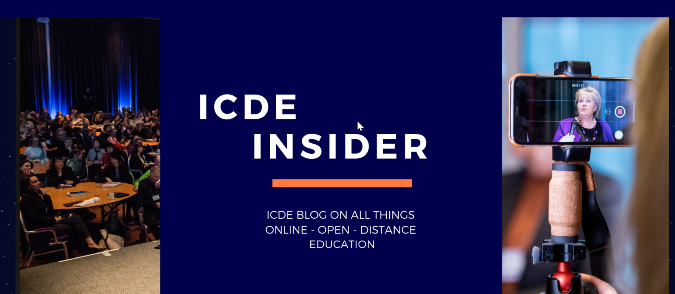

Join the global community of ICDE
Join our community – become a member
Subscribe to our newsletter
Follow us on Facebook, Linkedin and Twitter
Read our blog
Read our scientific Open Scholarly Journal Open Praxis
Notes:
And finally, I would like to encourage and welcome those of you who are not yet members of ICDE to join our global community by becoming members.
Please also follow us on social media, subsribe to our newsletter and check out our scientific open scholarly journal Open Praxis.

Slide 13
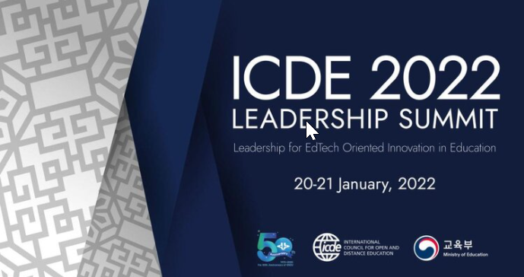
Upcoming conference: register at www.icde.org
Notes:
And last, but not the least: Don’t miss out on our upcoming conference – the ICDE Leadership Summit 2022, that takes place as a hybrid event, hosted by Korea National Open University in Seoul 20-21st January. This conference allows for both virtual and onsite participation. A series of questions and issues related to the conference theme of Leadership for EdTech Oriented Innovation in Education will be addressed during these two days in a dynamic and engaging format. We hope to see many of you there!

Slide 14
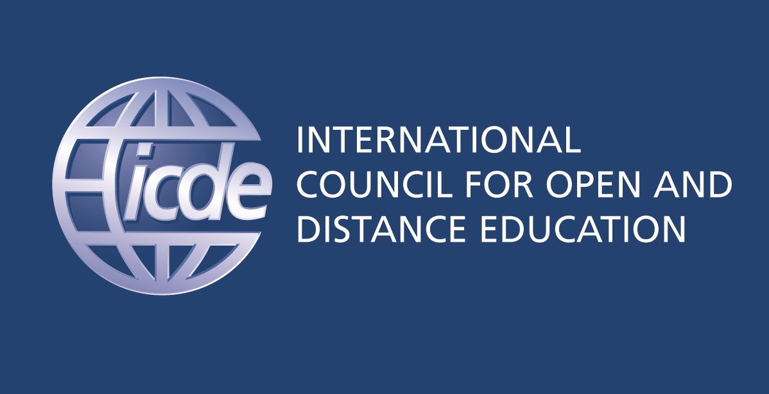
Thank you!
Contact the ICDE Secretariat:
icde@icde.org
Anaïs Malbrand
malbrand@icde.org
Notes:
And finally, I would like to encourage and welcome those of you who are not yet members of ICDE to join our global community by becoming members.
Please also follow us on social media, subsribe to our newsletter and check out our scientific open scholarly journal Open Praxis.

